Slide 1
The World of Donkeys
Understanding and Appreciating Donkeys

Slide 2
Introduction to Donkeys
Donkeys, also known as burros or asses, are domesticated members of the horse family
They have been used as working animals for at least 5000 years, known for their strength, intelligence, and adaptability
Despite their significant contributions, donkeys are often undervalued and misunderstood

Slide 3
Donkeys in Agriculture
Donkeys play a crucial role in agriculture, especially in developing countries
They are used for plowing fields, transporting goods, and carrying water, proving indispensable for smallhold farmers
Their ability to work in difficult terrains makes them exceptionally valuable in rural communities

Slide 4
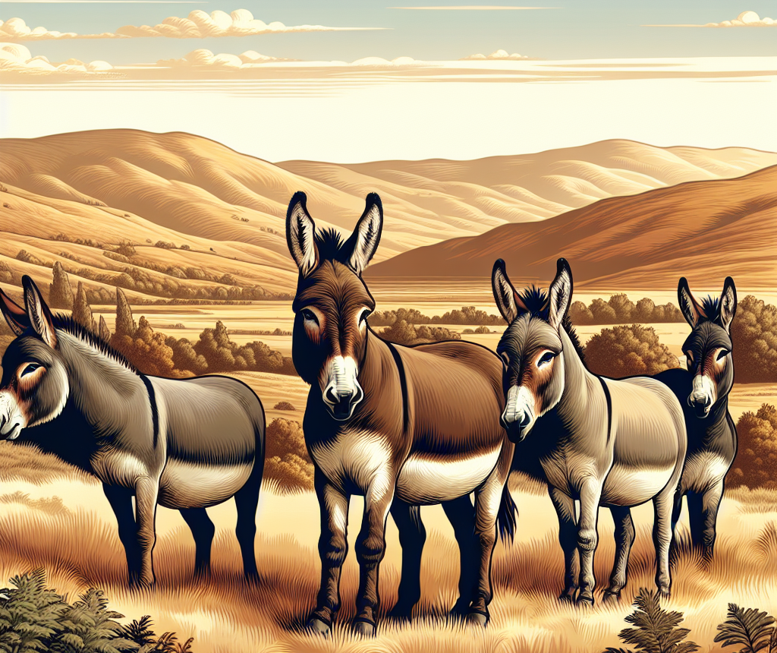
Characteristics and Behavior
Donkeys are recognized for their patience, cautious nature, and strong memory
They possess a keen sense of self-preservation, often mistaken for stubbornness
Unlike horses, donkeys are more independent and can make decisions to ensure their safety

Slide 5
Breeds of Donkeys
There are over 150 breeds of donkeys worldwide, varying in size, color, and temperament
Popular breeds include the Miniature Donkey, known for its small size and friendly nature, and the Mammoth Donkey, the largest domesticated breed
Breed characteristics can significantly influence a donkey's suitability for different types of work or environments

Slide 6
The Importance of Welfare
Donkey welfare is a growing concern, with issues arising from neglect, overwork, and lack of proper medical care
Efforts to improve donkey welfare include educational programs for owners, access to veterinary services, and rescue operations
Understanding and addressing the needs of donkeys are crucial for their well-being and productivity

Slide 7
Donkeys in Culture and History
Donkeys have a rich history intertwined with human civilization, appearing in ancient texts, art, and mythology
They symbolize patience, endurance, and humility in various cultures
Despite their significant role, societal attitudes towards donkeys vary, often influenced by historical and cultural contexts

Slide 8
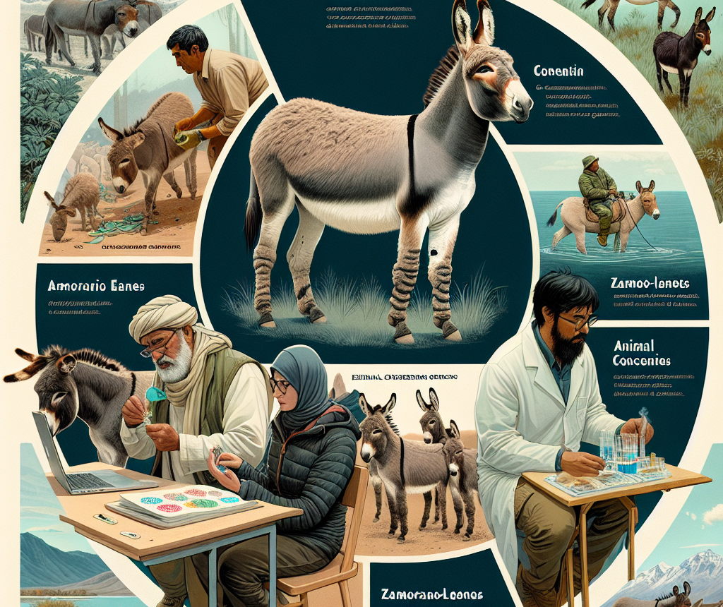
Conservation of Donkeys
Some donkey breeds are at risk of extinction due to modernization, loss of habitat, and cross-breeding
Conservation efforts are vital for preserving the genetic diversity and heritage of these breeds
Organizations worldwide are working to protect endangered breeds and promote sustainable practices

Slide 9
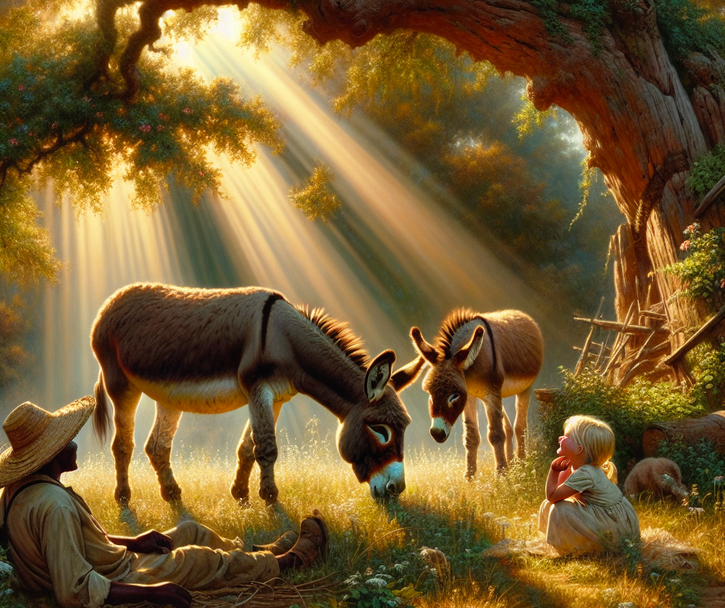
Conclusion
Donkeys are remarkable animals that have supported human societies for millennia
Their versatility, resilience, and endearing qualities make them invaluable to those who rely on them
It is our responsibility to ensure their welfare, preserve their legacy, and appreciate their contributions to our world

Slide 10
Thank You
Thank you for your attention!
Let's acknowledge the value of donkeys in our lives and work towards a better future for them

